Slide 1


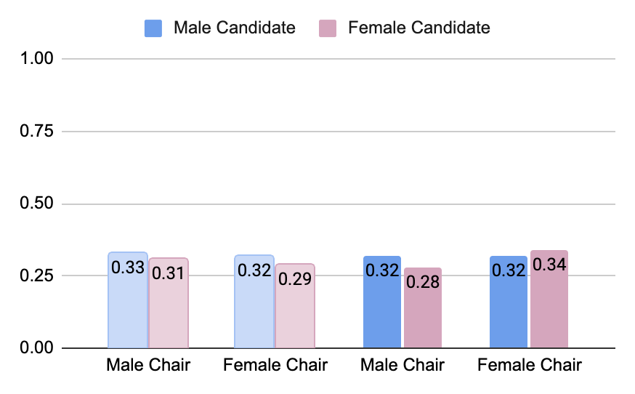
Gendered Recruitment
Clara Cullen, Jessica Dofelmire, Hannah Forsyth
Question
Does the gender of the party chair affect the perceived support of the male and female candidates?
Background
Past work finds that female respondents feel female candidate will receive less support from party chairs than male candidates.
This work does not account for the gender of the party chair.
Hypotheses
Support given to a candidate will correlate with the gender of the party chair.
Men and women with no experience will receive differing levels of perceived support
Sexism scores will be correlated with perceived support
Methodology
A survey of 2,447 politically active Utah voters (2,082 Republicans, 152 Democrats, 213 independents)
Designed an experimental survey to vary the gender of the party chair and candidate.
Used factor analysis to create support index for our dependent variable
Survey Vignette
Perceived Support by Benevolent and Hostile Sexism
Imagine [Mary/Paul] Thompson, your party's state party chair, was evaluating whether to recruit the following individual to run for a state legislative seat:
Name: [Jane/John] Wilson
Age: 44
Family Situation: Married for 15 years; 2 kids
Professional Background: Real Estate Agent
Political Experience: [None/ 4 years as county party chair]
After some consideration, [Mary/Paul] Thompson, your party's state party chair, decides to make a personal appeal to [Jane/John] Wilson to run for the state legislative seat. In your view, how likely is it that the state party chair, [Mary/Paul] Thompson, will ...
{Options on 5-point scale: Extremely unlikely, Somewhat unlikely, Neither likely nor unlikely, Somewhat likely, Extremely Likely}
-Meet with [Jane/John] Wilson to discuss campaign strategy.
-Introduce [Jane/John] Wilson to prominent campaign donors and encourage his/her executive board to invest extra campaign funds into [Jane/John]’s race.
-Help [Jane/John] Wilson get meetings with prominent politicians (governor, Member of Congress, etc.) to secure their endorsement.
-Help [Jane/John] Wilson receive necessary training.
-Help [Jane/John] Wilson by offering resources from the state party to assist in campaigning.
Results
Low coefficients, basically no statistically significant results
Results indicate that the gender of the party chair does not impact the perceived support for candidates, regardless of the candidate’s gender
As benevolent sexism scores increase perceived support for female candidates decrease and for male candidates they increase.
Discussion
We suspect that participants knew they were being tested about their thoughts on gender.
Future research could readminister the experiment in a broader survey, so respondents are not primed to focus on gender.
Gendered Support by Political Experience
No Political Experience
4 Year Political Experience

