Slide 1


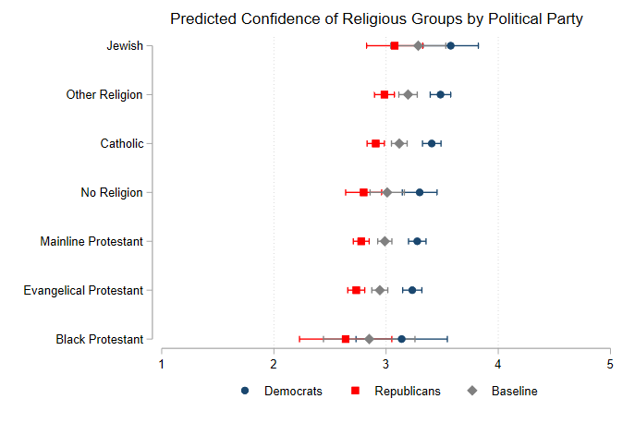
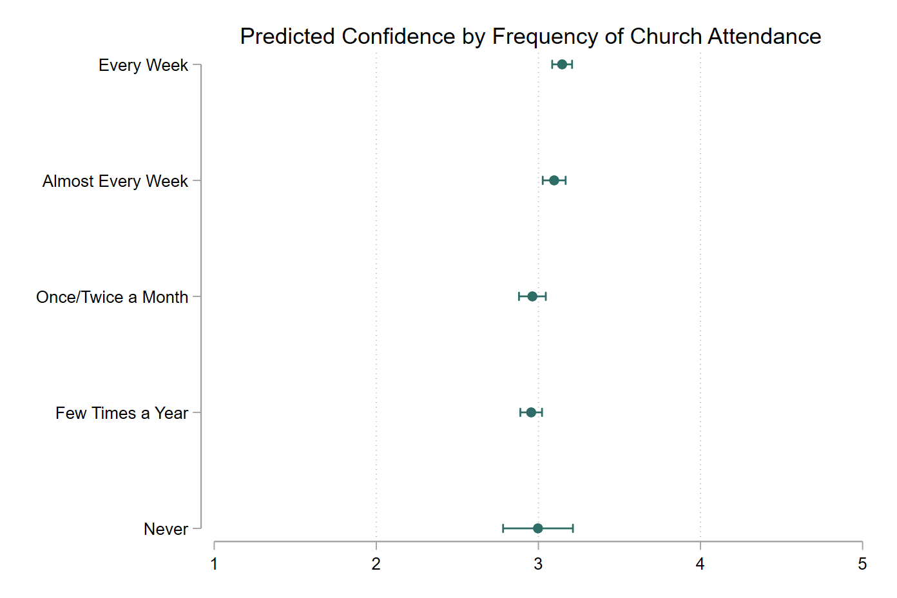
Religious Affiliation and Confidence in the 2020 Election
Jessica Dofelmire & Jacob Lunt | Dr. Kelly D Patterson
INTRODUCTION
Evangelical Protestants and other right wing Christians were among President Trump’s most ardent supporters
Considering the partisan signaling about the accuracy of the election and the correlation between religious affiliation and partisanship, we investigate whether religious affiliation is correlated with confidence in the 2020 election.
We expect that Evangelical Protestants will exhibit lower confidence at statistically significant levels when compared to non-religious voters.
FINDINGS
Neither Evangelical Protestant nor Mainline Protestants voters were significantly less confident that their vote would be accurately counted.
Voters in the Other Religion group were more confident than non-religious voters that their vote would be counted accurately.
More frequent church attendance is significantly correlated with confidence in the vote count independent of religious affiliation.
Compared to independents, strong and independent Democrats were more confident, while strong and independent Republicans were less confident.
Figure 1 illustrates that compared to independents, Republicans are less confident than Democrats that their vote would be counted accurately. It also shows that only Jews and voters in the Other Religion group were significantly more confident than non-religious voters.
DISCUSSION
It could be that familiarity with and confidence in religious institutions correlates with confidence in governmental institutions.
Those involved in religious communities are also often involved civically, so voters who attend religious services more frequently are likely more civically involved as well, leading to increased confidence in local election procedures.
It is important to note that this data was gathered before the election. Further research could focus on confidence levels after the election and whether religious affiliation is significant after increased partisan signaling about the accuracy of the election results.
METHODS
Data: American National Election Studies 2020 Time Series Study.
OLS models regressing religious affiliation on confidence in vote count accuracy controlling for voters’ party identification, sex, and the frequency of church attendance.
Voters reported their own religious affiliation and the responses were grouped using the RELTRAD framework.
Voters were asked before the election to report their confidence that their vote would be counted accurately on a scale of 1 to 5 with 5 being complete accuracy.
Figure 2 shows the predicted confidence of voters based on the frequency of their church attendance. Interestingly, religious affiliation and frequency of church attendance do not interact.

